Slide 1
E-RATE PROGRAM
E-Rate = Education Rate
The Schools and Libraries Program of the Universal Service Fund.
The Universal Service Fund consists of 4 programs:
High Cost – Consumer based telephone service.
Lifeline – Consumer based telephone service.
Rural Health Care – Telecommunication and bandwidth for rural health care providers.
Schools & Libraries – “E-Rate”
A program of the Federal Communications Commission (FCC).
Administered by the Universal Service Administrative Company (USAC).
Schools & Libraries Division (SLD) of USAC has responsibility.

Slide 2
E-RATE PROGRAM
Annual Budget is $3.9 Billion per year, indexed to inflation.
(unused funds from previous years can be rolled over into the current year)
The E-Rate program provides discounts to assist schools and public libraries to attain affordable telecommunications and bandwidth.
Discounts range from 20% to 90% of the cost of products and services prorated to the USDA National School Lunch Program AND the urban or rural status of the applicant’s school district.

Slide 3
E-RATE PROGRAM
Discount Matrix
% of students eligible for the National School Lunch Program | CATEGORY ONE |  | CATEGORY TWO
 | URBAN | RURAL | URBAN | RURAL
Less than 1% | 20% | 25% | 20% | 25%
1% to 19% | 40% | 50% | 40% | 50%
20% to 34% | 50% | 60% | 50% | 60%
35% to 49% | 60% | 70% | 60% | 70%
50% to 74% | 80% | 80% | 80% | 80%
75% to 100% | 90% | 90% | 85% | 85%

Slide 4
E-RATE PROGRAM
Who qualifies?
Individual K-12 schools, public or private
School Districts
Public libraries
Non-profit K-12 schools with endowments less than $50 Million
Consortia. (Any combination of the above.)

Slide 5
E-RATE PROGRAM
Eligible Products/Services
Each year the FCC will issue an Eligible Services List (ESL)
2017 ESL Click Here!

Slide 6
E-RATE PROGRAM
Eligible Products/Services
Category 1:
Data Transmission Services and Internet Access
Voice Services (subject to phase down)
Category 2:
Internal Connections
Managed Internal Broadband Services
Basic Maintenance of Internal Connections
Eligible voice services are subject to an annual phase down of support started in 2015.

Slide 7
E-RATE PROGRAM
Category 2 Budget (pre-discount)
K12
5-year budget
$150 per student.
Public Libraries
$2.30 urban
$5 per sq. ft. rural

Slide 8
E-RATE PROGRAM
Ineligible Products/Services
End-user devices
Monitors
Speakers
Projectors
Whiteboards
Laptops & desktops
Application software
Printers & scanners
Network security
Content filtering
(Content filtering is required by the Children’s Internet Protection Act CIPA)
Paging
Telephone components
Directory assistance charges
Text messaging
Custom calling
Direct inward dialing
900/976 call blocking
Inside wire maintenance plans
E-mail
Web hosting
Voice mail
Text messaging

Slide 9
E-RATE PROGRAM
2016
2016 Budget 2016 Demand Estimate | $3,939,000,000 $3,609,000,000
Unused 2016 Budget | $ 330,000,000
Available Rollover Funds Unused | 1,900,000,000
2017 Budget | 3,940,000,000
Potential 2017 Spend | $6,170,000,000

Slide 10
E-RATE PROGRAM
FCC Form 498
(Block 12 & 13)
To request a 498 ID, formerly called the Service Provider Identification Number (SPIN).
Once a 498 ID is obtained, service providers can update and review information online at the USAC website.
For assistance call: 1-888-641-8722, option 5
FCC Form 473
Service providers that already have a 498 ID must file a Service Provider Annual Certification Form (FCC Form 473, SPAC).
Form is in the E-File portal.
Your 1st step!
Don’t get whacked
because you haven’t filed a SPAC!

Slide 11
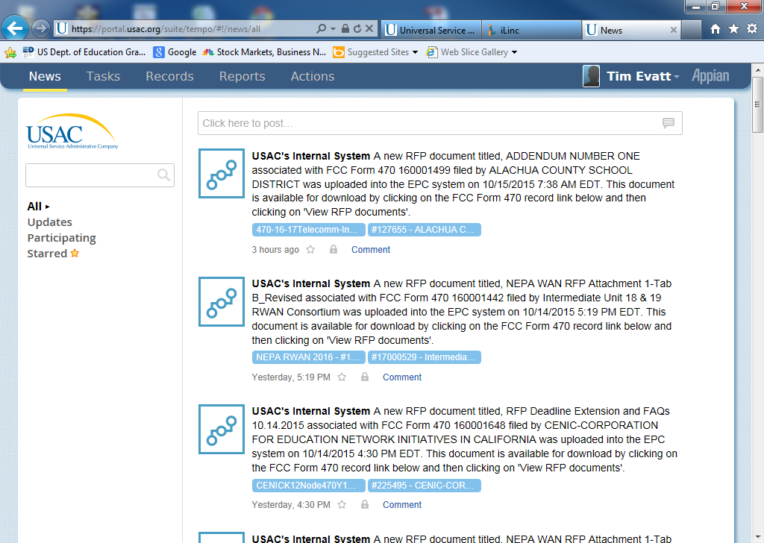
E-RATE PROGRAM
E-Rate Productivity Center (EPC)
The account and application management portal.
Your 2nd step!
New!
Forms
Documentation
Customer lists
Communications

Slide 12
E-RATE PROGRAM
FCC Form 470
Filed by applicant (end user).
Opens the competitive bidding process. May be used in conjunction with a formal bid.
Describes products/services.
Identifies the category of products/services
Identifies end users.
USAC will post 470’s in EPC.
Also available via SYNNEX Digital Navigator
Exception:
Applicants seeking to purchase commercially available business-class Internet access services that cost $3,600 or less per year (including any one-time installation and equipment charges).
Your 3rd step!
Bid!

Slide 13
E-RATE PROGRAM
After winning bid is chosen
FCC Form 471
Filed by the applicant (end user).
Officially requests discount funds from USAC.
Item 21 (template)
Filed by Service Provider
A description of the products/services.
Equipment locations
Diagrams & schedules of installations
Line item detail with costs outlining eligible and ineligible products/services
Additional details such as equipment locations and footnotes to line items
Your 4th step!

Slide 14
E-RATE PROGRAM
Funding Commitment Decision Letter (FCDL)
Issued to both applicant and service provider by USAC.
Available in EPC.
Issued in weekly cycles called “waves”.
Establishes that USAC will pay the discount percentage of products/services or details reasons the request is denied.
Service provider can now deliver products/services.

Slide 15
E-RATE PROGRAM
FCC Form 486 Receipt of Service Confirmation
Filed by applicant
Authorizes USAC to pay invoices
Notifies USAC of initial service start dates
Certifies compliance with the Children’s Internet Protection Act (CIPA)

Slide 16
E-RATE PROGRAM
Billing Methods
Billed Entity Applicant Reimbursement (BEAR, Form 472) –
Submitted by the applicant to USAC after they have paid service providers for products/service in full.
For FY2016 and beyond, applicants will receive direct reimbursement from USAC.
Service Provider Invoice (SPI, Form 474) –
Submitted by the service provider to USAC requesting reimbursement for products/services already provided and not paid for by the end user. aka-The amount of the discount.

Slide 17
E-RATE PROGRAM
Lowest Corresponding Price
The lowest price that a service provider charges to non-residential customers within the same geographic service area as an eligible entity.
The only exception is an official finding that this price is no longer “compensatory”.
Higher cost to deliver services
The applicant does not have to ask for LCP.
Service Providers are responsible to provide LCP to applicants.
Includes promotional rates offered for a period greater than 90 days.

Slide 18
E-RATE PROGRAM
Form 470
Form 471
Form 486
Form 472/474
Sequence of Major Forms
Form 472 filed by School or Library
Form 474 filed by Service Provider
Filed by School
or Library
Filed by School
or Library
Filed by School
or Library
Opens bidding
process
Requests funding
from USAC
Receipt of
Service
Billing Forms
Bids are awarded
(Form 470 must be Open for
a minimum of 28 days)
Form
473
Service Provider
Annual Certification

Slide 19
E-RATE PROGRAM
Annual Schedule
Funding Year
July 1 – June 30
Form 470’s Filed
July 1 –
Mid February
Form 471 Window Opens:
Mid January
Last day to open a Form 470:
Mid February
Form 471 Window Closes:
Mid March
Form 470 officially
opens the solicitation.
Bids/RFP’s are optional at local discretion.
Form 471 officially
requests funding from
E-Rate.

Slide 20
RECOMMENDATIONS
File FCC Form 498 to get your Service Provider Identification Number (498 ID).
File your FCC Form 473 Service Provider Annual Certification.
Maintain correct information on USAC site year-round.
Set up your EPC account!
Maintain any documentation or communication for 10 years past the last day of the funding year or the service delivery date (whichever is latter).
Include full details on all billing such as serial numbers, product descriptions, Form 471 Application Number.

Slide 21
RECOMMENDATIONS
E-Rate is a year-round task, diligently monitor and communicate with your customer and keep records continuously throughout the year.
Keep up with changes in the rules. The FCC can issue Orders, instructions and judgments at any time throughout the year.
Carefully read all forms and check for errors. There are civil and criminal penalties for violating any certifications made by signing these forms.
Strictly adhere to stated deadlines. There are exceptions, but don’t take chances. Extensions may be available.
Promptly and accurately respond to any inquiries from USAC.

Slide 22
ADDITIONAL INFORMATION
Universal Service Administrative Company website:
www.usac.org/sl
USAC phone: 888-203-8100 (Client Service Bureau)
E-Rate Central (E-Rate consulting for applicants)
www.e-ratecentral.com (sign up for newsletter)
SYNNEX Government Programs website:
www.govsolv.com
SYNNEX Digital Navigator
www.governmentnavigator.com
(Login required, see SYNNEX GOVSolv team.)

Slide 23
ADDITIONAL INFORMATION
USAC Services
On the USAC website: www.usac.org/sl
Service Provider Webinar
Weekly webinar with USAC personnel (must register every week on USAC website)
Reports on funding waves and levels
Question & answer session
Every Tuesday, 12:00 eastern
Schools and Libraries News Brief
Weekly email news and announcements
Sign up for EPC!

