Slide 1

Depend on SYNNEX SERVICESolv: Contact your SYNNEX sales rep or email fieldservices@synnex.com today.
Selling Services Just Became Simple
Extra Mile Services includes:
Wireless site surveys and installations
Onsite network installation
Physical security
Audio-Visual Systems
Telephony
Digital signage, networking equipment, wireless equipment, etc.
Pulling Cable
Fleet Services
Training Services includes:
Google, SAP, Red hat, Microsoft, VMWare, Apple. Etc
Avaya, Cisco, Mitel, Shortel, etc
Warranty and Depot Services:
Chromebooks & Tablets
ProAV Products
Desktops/notebooks
Printers
Mobility
“Smart Hands” – Need a hand with routine, install-related tasks?
Complementing the other Extra Mile Services offerings, Smart Hands is a convenient way for you to save time and money! Add Smart Hands service and SYNNEX will provide skilled personnel to complete the installation to each customer’s specifications. The Smart Hands service can include:
Unpacking boxes
Connecting hardware
Loading software
Even trash disposal and cleanup – to keep your reputation spotless!
Software Services
Consultation
Assessment
Implementation
Migration
Health Check
Training
Product Demos
Cloud
Helpdesk
Disaster Recovery
Staff Augmentation

Slide 2








Synnex Software Services
Consultation—Discovery of business case, system configuration and system requirements
Assessment— Analysis of current system performance and configuration
Implementation—Complete system installation and Go-Live
Migration—Migrate operating system, database, applications
Health Check — Environment analyzation and optimize with best practices
Training—Professional development, certifications, knowledge transfer onsite and remote
Product Demos—On-premise or remote system demonstrations available
Cloud— Hosting, Installation and On-premise migration
Helpdesk- Center of Excellence
Disaster Recovery Blueprint Practice
Fieldservices@synnex.com

Slide 3
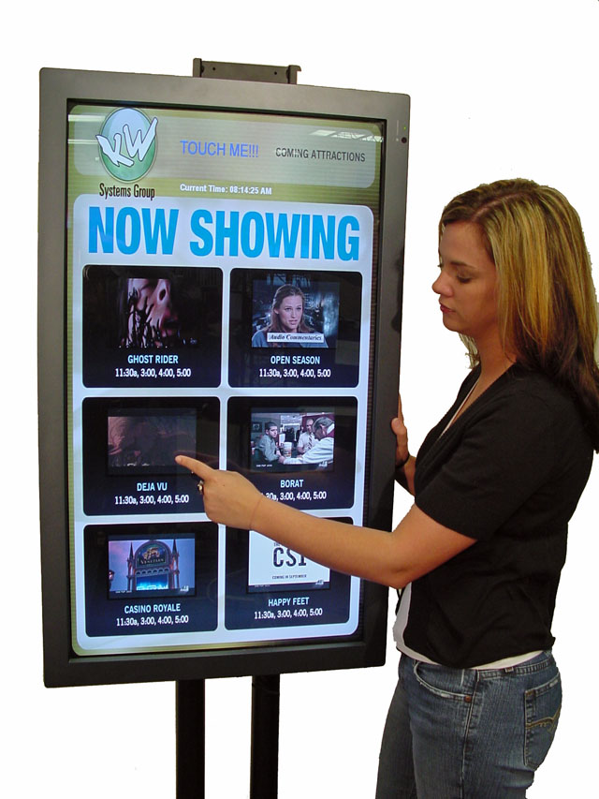





Simplified SKU’d Services
Installation services
Cable services
Staff Aug - Tech
SOSLGDSINST70 | Flat rate to install a LG Digital Display up to a 70" screen size.
SOSPANDSINST36 | Flat rate to install a Panasonic Digital Display up to a 36" screen size.
SOSSNYDSINST48 | Flat rate to install a Sony Digital Display up to a 48" screen size.
SOSSAMDSINST36 | Flat rate to install a Samsung Digital Display up to a 36" screen size.
Fieldservices@synnex.com

Slide 4
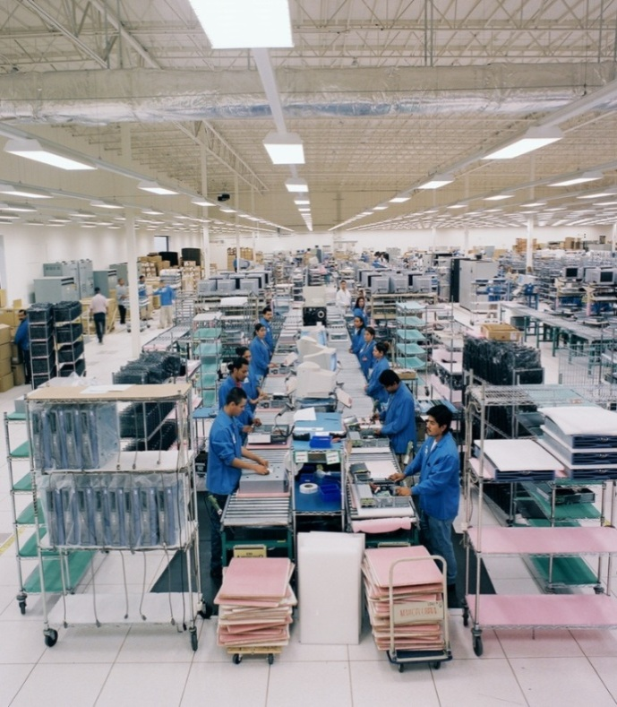
Integration Solutions – Production Value Add
Olive Branch, MS
Built to Order configuration and customization of IT products to your customer’s specifications
Enhance your capabilities and solution offerings—without adding infrastructure or staff
ISO9001 certified
Why SYNNEX Integration?
Services Offerings:
Hardware Integration
Imaging/Software Install
Asset Tagging/UID
Bundling/Kitting
Server/Rack Builds
Laser Etching
White Glove Services
Fieldservices@synnex.com

Slide 5
Key Takeaways
Generate additional revenue
Expand your sales reach
Increase margin
Expand your product and services portfolio
Fieldservices@synnex.com

