Slide 1
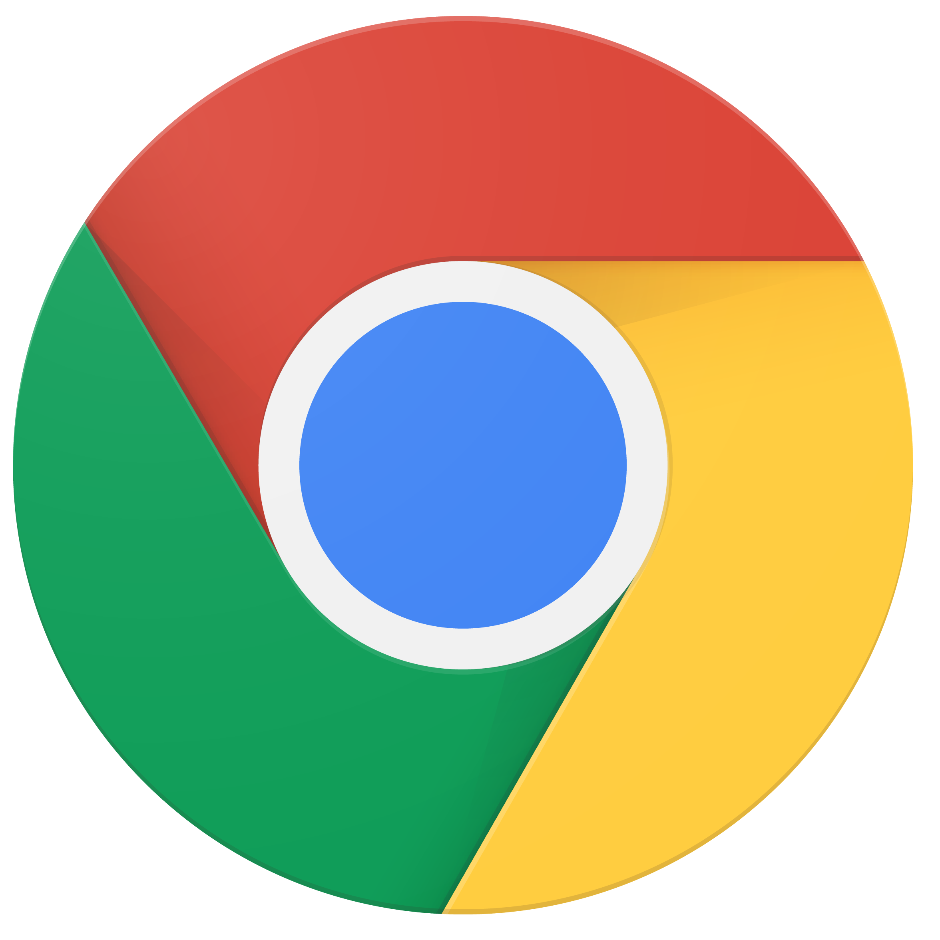
Enable remote workers with Chrome Enterprise
Keep your workforce connected, productive and secure from anywhere
Key benefits of deploying Chrome Enterprise for remote workers
Chrome Enterprise is a modern, secure platform that empowers a remote workforce, allowing employees to be productive from any location and providing IT with the ability to manage devices remotely.
Remote Work Statistics
84% of people work in virtual teams.¹
54% of HR leaders indicated that poor technology is the biggest barrier to effective remote working.²
Secure by design
Chromebooks have built-in security to help protect from external threats, security patches can be deployed over WiFi, and IT can remotely disable devices if needed.
Cloud management
IT admins manage devices and users from anywhere with the Google Admin console. They can easily enforce policies, configure device settings, provide access to VPNs, and force install Chrome apps and extensions across Chrome Browser and OS.
Easy access to apps
Employees can access the apps they need through Chrome Browser, the managed Google Play Store, or VDI solutions. Chromebooks also go hand-in-hand with G Suite and other productivity, collaboration and meeting solutions.
Fast deployment
Businesses can deploy Chromebooks quickly with cloud-based profiles that download users’ policies, apps, settings, and bookmarks. No imaging required.
Chrome Device Deployment Guide
This is a guide for IT administrators who want to deploy Chrome devices to enable remote workers. In this guide, you’ll learn:
How to enroll Chrome devices.
How to use the Google Admin console to remotely manage Chrome devices.
Key configuration settings for cloud-based policies and Chrome apps.
How to set and deploy device and user policies across your organization.
Access the guide here.
¹https://www.citrix.com/content/dam/citrix/en_us/documents/other/workforce-flexibility-can-drive-greater-engagement-and-productivity.pdf
²https://www.gartner.com/smarterwithgartner/with-coronavirus-in-mind-are-you-ready-for-remote-work/

Slide 2
5 tips to keeping your remote workforce empowered and secure with Chrome Enterprise
1
Configure network settings to allow for remote access
Make sure devices have the right policies for Wi-Fi, Ethernet, and virtual private network (VPN) access. Additionally, add and manage certificates from the Google Admin console. Learn more
Keep corporate data secure with the ability to disable devices remotely
Administrators can disable a Chrome device directly from the Google Admin console if it’s lost or stolen and even post a message that lets the finder know where to return it. Learn more
Check Google Safe Browsing settings to keep your employees and data secure
With Google Safe Browsing, users are warned of malicious sites before they navigate to them, deterring negligent behavior. IT admins can enable and configure this setting from the Google Admin console. Learn more
Resolve technical issues with Chrome Remote Desktop
Chromebooks are easy to use and have the familiar Chrome Browser. However, if users are having issues, IT administrators can provide remote support with Chrome Remote Desktop. This feature allows IT admins to access a user’s device and help resolve issues quickly. Learn more
Manage Chrome browser from the cloud
Manage Chrome browsers on all operating systems through the Google Admin console so your IT can apply policies from anywhere. This gives IT the flexibility to work from different locations and ensures browsers are secure on both public and private networks. Learn more
Click here to learn about Chrome Enterprise Best Practices to enable remote workforce
Other resources to get started:
Online Chromebook simulator with interactive tutorials for employees
Install apps and extensions on managed Chrome devices
See more Chrome policies for users and browsers
Learn more about Chrome Enterprise
2
3
Most employees take their Chromebooks home at night. If weather or disasters prevent them from coming to the office, business goes on.”
Paul Driscoll Business Systems Manager, Third Bridge
4
5
© 2020 Google LLC 1600 Amphitheatre Parkway, Mountain View, CA 94043.

